Slide 1
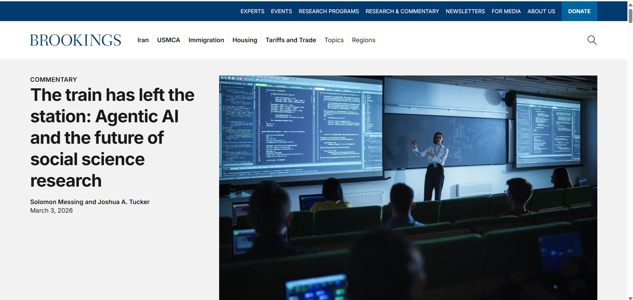
The train has left the station: Agentic AI and the future of social science research
By Solomon Messing and Joshua A. Tucker
March 3, 2026

Slide 2
Article Details
Article Publication Date: March 3, 2026
Article Number: NA Title of the Article: The train has left the station: Agentic AI and the future of social science research
Link to the source: https://www.brookings.edu/articles/the-train-has-left-the-station-agentic-ai-and-the-future-of-social-science-research/?utm_source

Slide 3
Summary of Key Points
This article explores the transformative impact of agentic AI-autonomous AI systems that can perform complex tasks on their own.
These AI agents, like Claude Code and OpenAI’s Codex, are revolutionizing research by automating tasks such as data analysis, literature reviews, and writing research papers.
While they boost productivity, the article highlights the risks of relying on AI, including errors in output, security vulnerabilities, and loss of technical skills among researchers.

Slide 4
Broader Implications for Society
The rise of agentic AI will significantly alter the role of human researchers.
While AI may democratize access to research tools and enhance productivity, it could also lead to the erosion of critical technical skills.
Moreover, AI’s rapid output may overwhelm academic publishing systems, raising concerns about the quality and quantity of submissions.

Slide 5

Relevance to the Construction Industry
Though focused on social science, agentic AI's implications extend to industries like construction.
In construction, AI agents could automate tasks like project management, data analysis, and planning.
These tools could help construction companies improve efficiency, reduce costs, and speed up project timelines.

